Slide 1
Recurrent Neural Networks

Slide 2
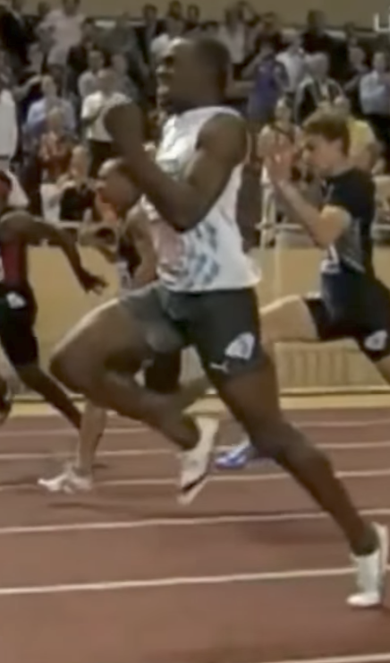
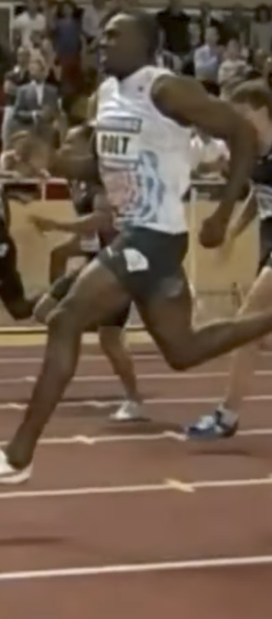
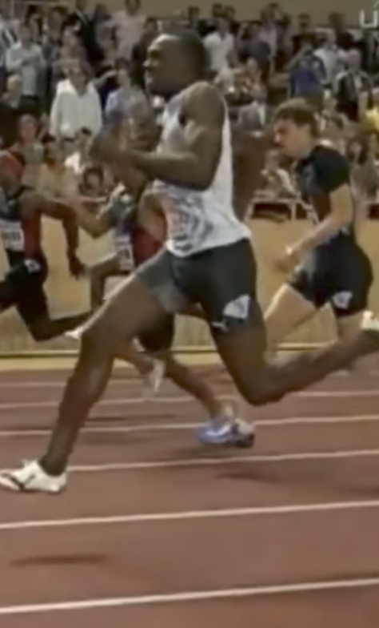
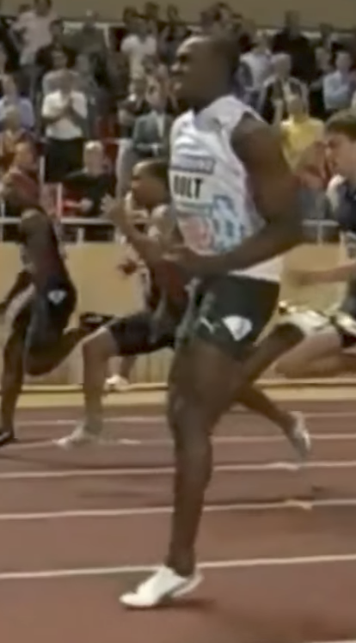
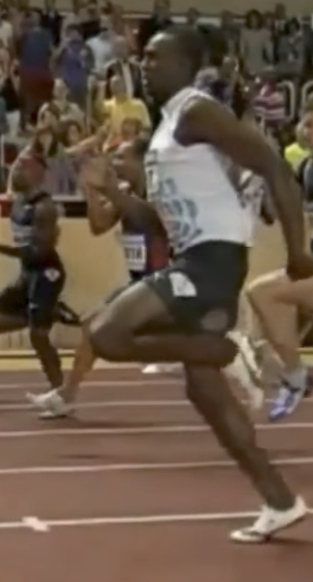

Examples of sequence data
“The quick brown fox jumped over the lazy dog.”
Konuşma Tanıma
Muzik Üretme
$$∅$$
Duygu sınıflandırması
“Bu filmde sevilecek hiçbir şey yok.”
DNA dizi analizi
AGCCCCTGTGAGGAACTAG
AGCCCCTGTGAGGAACTAG
Makine çevirisi
Voulez-vous chanter avec moi?
Do you want to sing with me?
Plasmid sequence AP4 Oligo
Video etkinliği tanıma
Koşma
İsim varlık tanınırlığı
Yesterday, Harry Potter met Hermione Granger.
Yesterday, Harry Potter met Hermione Granger.

Slide 3
Kelimeleri temsil etme
x:
Harry Potter and Hermione Granger invented a new spell.
$$x^{<1>}$$
$$x^{<2>}$$
$$x^{<3>}$$
$$⋯$$
$$x^{<9>}$$
And = 367
Invented = 4700
A = 1
New = 5976
Spell = 8376
Harry = 4075
Potter = 6830
Hermione = 4200
Gran… = 4000

Slide 4
Neden standart bir ağ değil?
$$x^{<1>}$$
$$y^{<1>}$$
$$x^{<2>}$$
$$y^{<2>}$$
$$⋮$$
$$⋮$$
$$⋮$$
$$⋮$$
$$x^{<T_{x}>}$$
$$y^{<T_{y}>}$$
Problemler:
Girişler, çıkışlar farklı örneklerde farklı uzunluklarda olabilir
Metnin farklı konumlarında öğrenilen özellikleri paylaşmaz

Slide 5
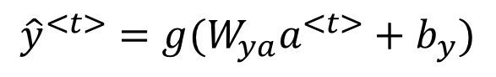
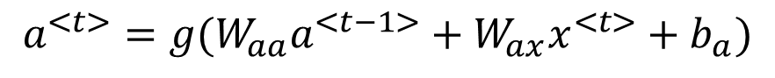
İleri Yayılım
$${\hat{y}}^{<1>}$$
$${\hat{y}}^{<2>}$$
$${\hat{y}}^{<3>}$$
$${\hat{y}}^{<T_{y}>}$$
$$a^{<1>}$$
$$a^{<2>}$$
$$a^{<T_{x}−1>}$$
$$a^{<0>}$$
$$⋯$$
$$x^{<1>}$$
$$x^{<2>}$$
$$x^{<3>}$$
$$x^{<T_{x}>}$$
$$a^{<t>}=g(W_{aa}a^{<t−1>}+W_{ax}x^{<t>}+b_{a})$$
$${\hat{y}}^{<t>}=g(W_{ya}a^{<t>}+b_{y})$$

Slide 6
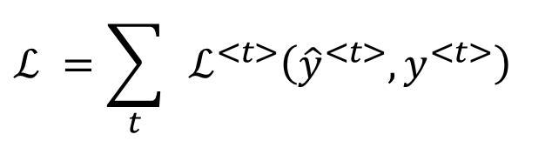
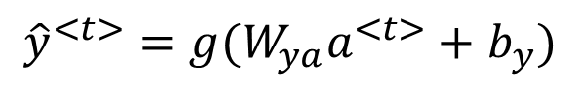
İleri yayılım ve geri yayılım
$${\hat{y}}^{<1>}$$
$${\hat{y}}^{<2>}$$
$${\hat{y}}^{<3>}$$
$${\hat{y}}^{<T_{y}>}$$
$$a^{<1>}$$
$$a^{<2>}$$
$$a^{<T_{x}−1>}$$
$$a^{<0>}$$
$$⋯$$
$$x^{<1>}$$
$$x^{<2>}$$
$$x^{<3>}$$
$$x^{<T_{x}>}$$
$${\hat{y}}^{<t>}=g(W_{ya}a^{<t>}+b_{y})$$
$$ℒ^{<t>}\left({\hat{y}}^{<t>},y^{<t>}\right)=$$
$$ℒ^{ }=\sum_{t}{ }ℒ^{<t>}\left({\hat{y}}^{<t>},y^{<t>}\right)$$

Slide 7
RNN türlerinin özeti
$${\hat{y}}^{<1>}$$
$${\hat{y}}^{<1>}$$
$${\hat{y}}^{<2>}$$
$${\hat{y}}^{<T_{y}>}$$
$${\hat{y}}^{ }$$
$$a^{<0>}$$
$$a^{<0>}$$
$$⋯$$
$$a^{<0>}$$
$$⋯$$
$$x^{<1>}$$
$$x$$
$$x^{<1>}$$
$$x^{<2>}$$
$$x^{<T_{x}>}$$
Bire bir
Birden çoğa
Çoktan bire
$${\hat{y}}^{<1> }$$
$${\hat{y}}^{<2> }$$
$${{\hat{y}}^{<1>}}^{ }$$
$${{\hat{y}}^{<T_{y}>}}^{ }$$
$${\hat{y}}^{<T_{y}> }$$
$$a^{<0>}$$
$$⋯$$
$$⋯$$
$$⋯$$
$$a^{<0>}$$
$$⋯$$
$$x^{<1>}$$
$$x^{<T_{x}>}$$
$$x^{<1>}$$
$$x^{<2>}$$
$$x^{<T_{x}>}$$
Çoktan çoğa
Çoktan çoğa

Slide 8
RNN’lerde kaybolan gradyanlar
$${\hat{y}}^{<1> }$$
$${\hat{y}}^{<2> }$$
$${\hat{y}}^{<3> }$$
$${\hat{y}}^{<T_{y}> }$$
$$a^{<0>}$$
$$a^{<1>}$$
$$a^{<2>}$$
$$a^{<3>}$$
$$⋯$$
$$a^{<T_{y}>}$$
$$x^{<1>}$$
$$x^{<2>}$$
$$x^{<3>}$$
$$x^{<T_{x}>}$$
$$x^{ }$$
$$⋯$$
$${\hat{y}}^{ }$$
$$⋮$$
$$⋮$$
$$⋮$$
$$⋮$$
$$⋮$$
$$⋮$$
$$⋮$$

Slide 9
Gated Recurrent Unit (GRU)

Slide 10
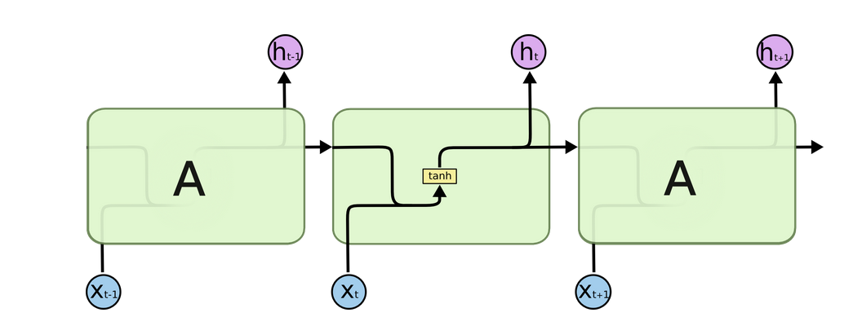
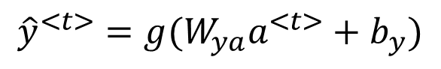
RNN unit
$${\hat{y}}^{<1> }$$
$$a^{<0>}$$
$$a^{<1>}$$
$$x^{<1>}$$
$${\hat{y}}^{<t>}=g(W_{ya}a^{<t>}+b_{y})$$
$$a^{<t>}=g(W_{a}\left[a^{<t−1>}, x^{<t>}\right]+b_{a})$$

Slide 11
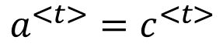
GRU
$${\tilde{c}}^{<t>}=\tanh{(W_{c}\left[Γ_{r}∗c^{<t−1>},x^{<t>}\right]+b_{c})}$$
$$Γ_{u}=σ{(W_{u}\left[ c^{<t−1>},x^{<t>}\right]+b_{u})}$$
$$Γ_{r}=σ{(W_{r}\left[ c^{<t−1>},x^{<t>}\right]+b_{r})}$$
$$c^{<t>}=Γ_{u}{∗{\tilde{c}}^{<t>}+\left(1−Γ_{u}\right)∗c^{<t−1>}}$$
$$a^{<t>}=c^{<t>}$$
The cat, which already ate …, was full.
[Cho et al., 2014. On the properties of neural machine translation: Encoder-decoder approaches]
[Chung et al., 2014. Empirical Evaluation of Gated Recurrent Neural Networks on Sequence Modeling]

Slide 12
LSTM (long short term memory) unit

Slide 13
LSTM in pictures
$$y^{<t>}$$
$${\tilde{c}}^{<t>}=\tanh{(W_{c}\left[a^{<t−1>},x^{<t>}\right]+b_{c})}$$
softmax
$$a^{<t>}$$
$$Γ_{u}=σ{(W_{u}\left[ a^{<t−1>},x^{<t>}\right]+b_{u})}$$
-
-
$$c^{<t−1>}$$
$$c^{<t>}$$
-
*
$$⨁$$
-
$$Γ_{f}=σ{(W_{f}\left[ a^{<t−1>},x^{<t>}\right]+b_{f})}$$
$$c^{<t>}$$
*
tanh
$$Γ_{o}=σ{(W_{o}\left[ a^{<t−1>},x^{<t>}\right]+b_{o})}$$
$$a^{<t−1>}$$
*
$$a^{<t>}$$
$$f^{<t>}$$
$$i^{<t>}$$
$${\tilde{c}}^{<t>}$$
$$o^{<t>}$$
$$a^{<t>}$$
$$c^{<t>}={Γ_{u}∗{\tilde{c}}^{<t>}+Γ_{f}∗c^{<t−1>}}$$
forget gate
update gate
tanh
output gate
$$a^{<t>}=Γ_{o}∗c^{<t>}$$
$$x^{<t>}$$
$$y^{<1>}$$
$$y^{<2>}$$
$$y^{<3>}$$
softmax
softmax
softmax
$$a^{<1>}$$
$$a^{<2>}$$
-
$$c^{<2>}$$
$$a^{<3>}$$
-
-
$$c^{<1>}$$
-
-
$$c^{<3>}$$
-
-
-
-
-
-
$$c^{<0>}$$
*
$$⨁$$
-
$$c^{<1>}$$
*
$$⨁$$
$$c^{<2>}$$
*
$$⨁$$
$$a^{<0>}$$
$$a^{<1>}$$
$$a^{<2>}$$
$$a^{<2>}$$
$$a^{<1>}$$
$$a^{<3>}$$
$$x^{<1>}$$
$$x^{<2>}$$
$$x^{<3>}$$

Slide 14
Bidirectional RNN
Çift Yönlü RNN

Slide 15
Gelecekten bilgi almak
He said, “Teddy bears are on sale!”
He said, “Teddy Roosevelt was a great President!”
$${\hat{y}}^{<1> }$$
$${\hat{y}}^{<2> }$$
$${\hat{y}}^{<3> }$$
$${\hat{y}}^{<4> }$$
$${\hat{y}}^{<5> }$$
$${\hat{y}}^{<6> }$$
$${\hat{y}}^{<7> }$$
$$a^{<0>}$$
$$a^{<1>}$$
$$a^{<2>}$$
$$a^{<3>}$$
$$a^{<4>}$$
$$a^{<5>}$$
$$a^{<6>}$$
$$a^{<7>}$$
$$x^{<1>}$$
$$x^{<2>}$$
$$x^{<3>}$$
$$x^{<4>}$$
$$x^{<5>}$$
$$x^{<6>}$$
$$x^{<7>}$$
He said, “Teddy bears are on sale!”

Slide 16
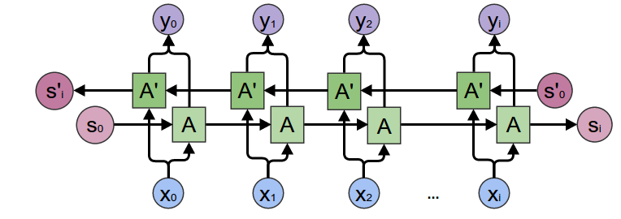

Slide 17
Derin RNNs

Slide 18
Derin RNN örneği
$$y^{<1>}$$
$$y^{<2>}$$
$$y^{<3>}$$
$$y^{<4>}$$
$$a^{[3]<0>}$$
$$a^{[3]<1>}$$
$$a^{[3]<2>}$$
$$a^{[3]<3>}$$
$$a^{[3]<4>}$$
$$a^{[2]<0>}$$
$$a^{[2]<1>}$$
$$a^{[2]<2>}$$
$$a^{[2]<3>}$$
$$a^{[2]<4>}$$
$$a^{[1]<0>}$$
$$x^{<1>}$$
$$x^{<2>}$$
$$x^{<3>}$$
$$x^{<4>}$$

